Slide 1
Exponential Equations and their Applications

Slide 2
Basic Formula for any Exponential Equation
A = P (n)^{rt}

Slide 3
Solve for the missing variable
V = 5(2.1)⁷
1400 = 150(x)¹²
400 = 25(1.176)^{t}

Slide 4
Special Formula for Yearly Growth or Decay
Growth: A = P (1 + r)^{t}
Decay: A = P (1 - r)^{t}

Slide 5
Examples of yearly growth/Decay
Beth averages a 2% raise for her salary. The raise is effective each January 1st. If Beth’s Current Salary is $97,000, find her projected salary 8 years from now.
Each year in October, the new models for F-150 pick-up trucks come out. A used f-150 decreases in value around 16% from its previous year value at the same time. If a 2024 F-150 will be valued around $62,000 when it is released in October, find it’s projected value 6 years later.
When will the truck be predicted to be worth less than $20,000?

Slide 6
Formula for Continuous Growth or Decay
A = P (e)^{rt}

Slide 7




Slide 8
Examples of Continuous growth/Decay
The Population of Austin, Texas was 961,800 in the year 2020. The population of Austin was 974,500 in 2022. Assuming the growth is relatively continuous:
Find the percent rate of the population growth in Austin
Set up an equation to estimate the growth of Austin at any time t since 2020
Find the expected Population in the year 2024. How about 2027?
Estimate the year in which Austin’s population might exceed one million people

Slide 9
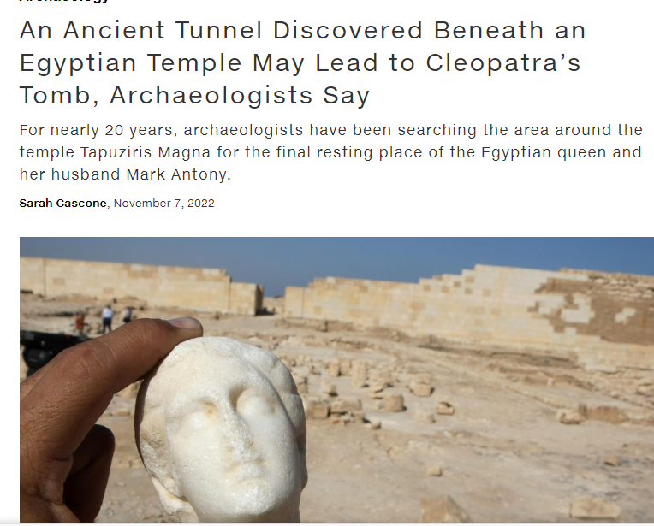
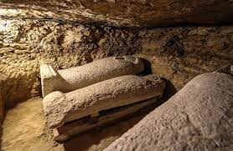
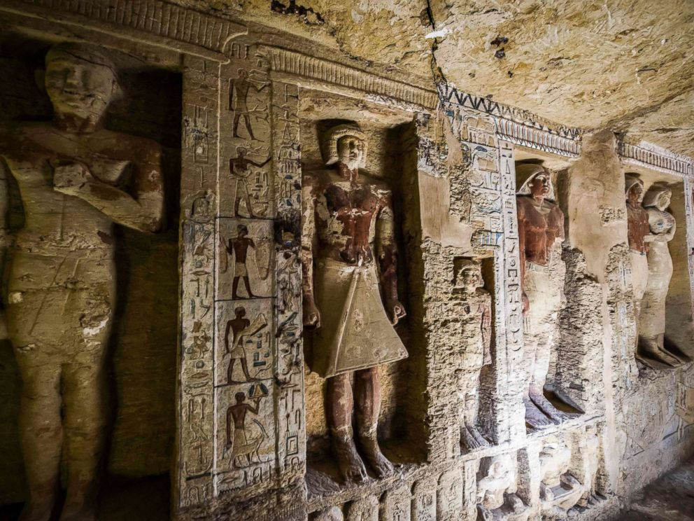

Slide 10
Examples of Continuous growth/Decay
2. Scientists can use carbon-dating to estimate the age of ancient artifacts. This can be done by measuring the amount of Carbon-14 contained in a substance at the time of discovery and comparing it to the amount of carbon-14 that should be present in a contemporary sample. a burial cloth in a recently discovered Egyptian tomb contains 59% of the Carbon-14 than it would have originally contained.
Create an equation to determine the amount of carbon-14 in an artifact at any time after burial. Use the fact that the half-life of carbon-14 is 5730 years (Use ln2/half-life to find rate)
Using your equation, estimate how long this Tomb has been sealed

