Slide 1
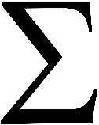
Exact Area Calculation Review
Find the area under each curve using infinity “n” rectangles:
y = x³ + x [0,3]
y = x² + 4x [0,1]
y = 3x² [0,2]
53
k3 + 2k²
k = 41

