Slide 1
Properties of Definite Integrals

Slide 2
Example 1

Slide 3
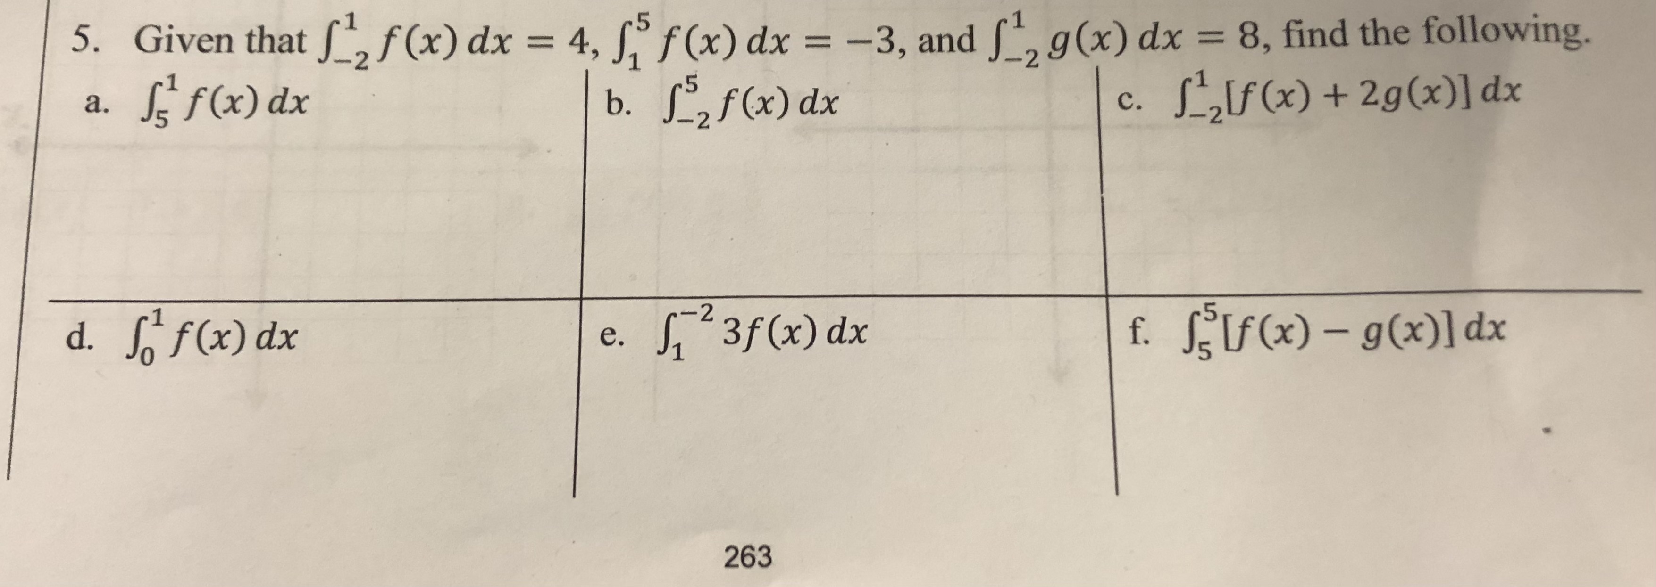
Example 2

Slide 4
Example 3

Slide 5
Example 4

Slide 6
Example 5

