Slide 1
Optimization Level 2 Problems

Slide 2
Fencing:
Question 1
A rectangular zoo enclosure is to be built using 300 feet of fencing. One side od the enclosure will be built next to an existing brick wall, so the fence will ony require three sides. What dimensions should be used to enclose the maximum possible area?
Question 2
Chik Fil-A wants to build a kids play area where the two sides that face the seating area and the highway are made of glass and the two sides that face the drive-thru and the parking lot are made out of brick. The glass will cost $180 per linear foot, and the brick will cost $120 per linear foot. The play ground needs to have a floor area of 1000 square feet. Minimize the cost of this Chik Fil-A playground

Slide 3
beverages
What radius would you use to minimize the aluminum used for a Dr. Pepper can that contains 355 ml of soda?
Hint 1 cubic centimeter is the same as 1ml

Slide 4
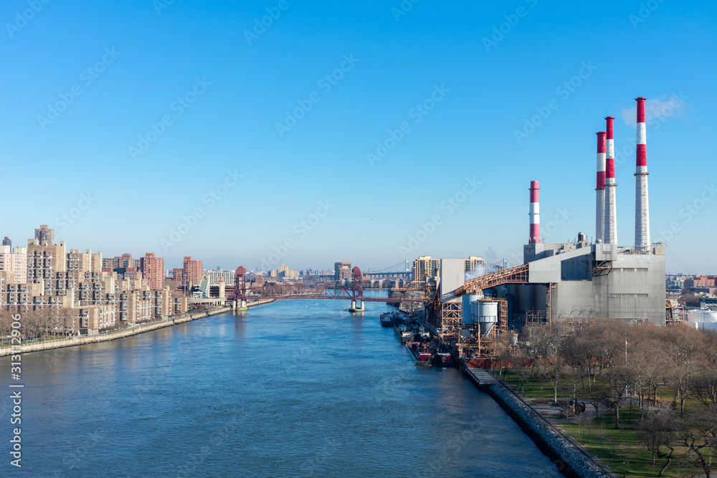
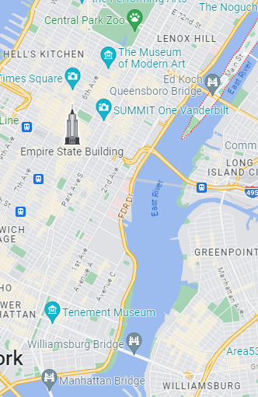
Multiple Surfaces
A power station sits on Roosevelt Island. Roosevelt Island sits in the middle of the East River, ½ mile east of Manhattan. A new skyscraper is being built near Battery Park, the neighborhood on Manhattan's southern tip. Battery Park is approximately 6 miles south of the Power Plant across the river.
If it costs $850,000 per mile to run cable underwater, and $600,000 per mile to run cable underground, find the least costly way to send power from the power station to the new skyscraper

