Slide 1
Comparing a function’s graph to the graph of its derivative

Slide 2
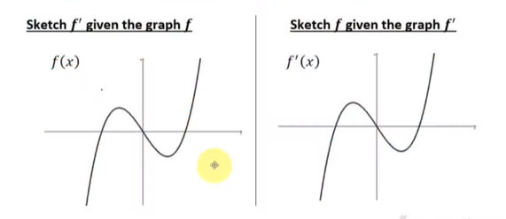
Two graphs that look exactly the same
But Are Not Even Close!!

Slide 3
Hints to make this process easier
Mark-Up graph immediately into zones
  A new zone is create every time graph’s behavior changes
For each zone determine the sign of both f’ and f’’
  Keep in mind how this affects the original function’s graph (inc/dec, concavity)
Use your zone notes to answer questions or sketch a new graph

Slide 4
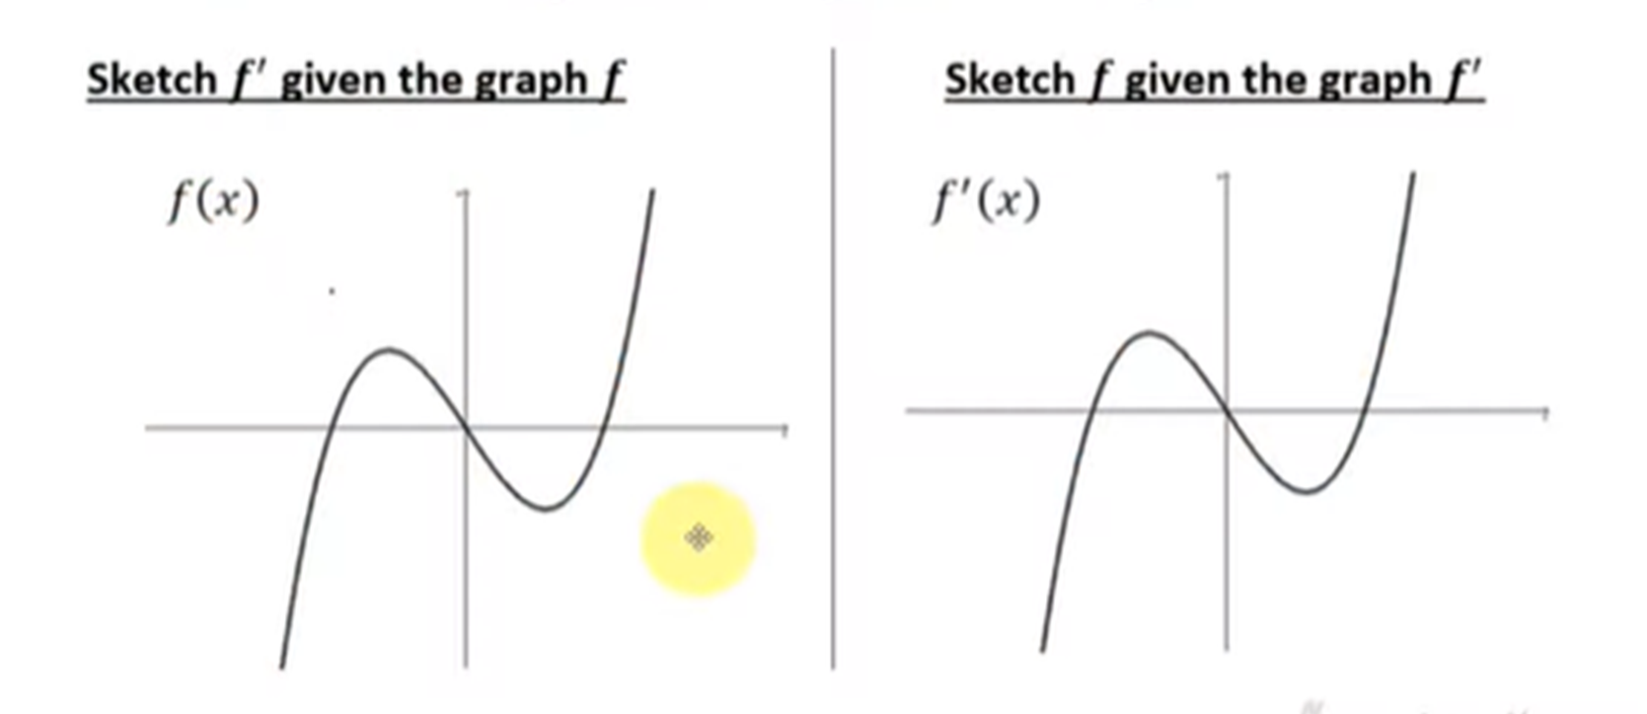

Slide 6
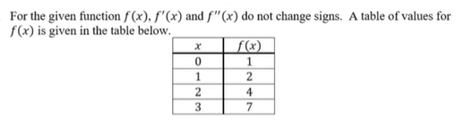
Extrapolating f’ and f’’ from a chart of f(x)
Is f(x) concave up or concave down?

Slide 7
Quick Re-visit of motion
A particle is moving one-dimensionally on the x-axis. Its position is given by the function: x(t) = 1/3t³ – 4t² + 12t

